Slide 1
VPC Privatelinks and Router53 Resolver
By:CHAKRAVARAM.SAITEJASWI

Slide 2
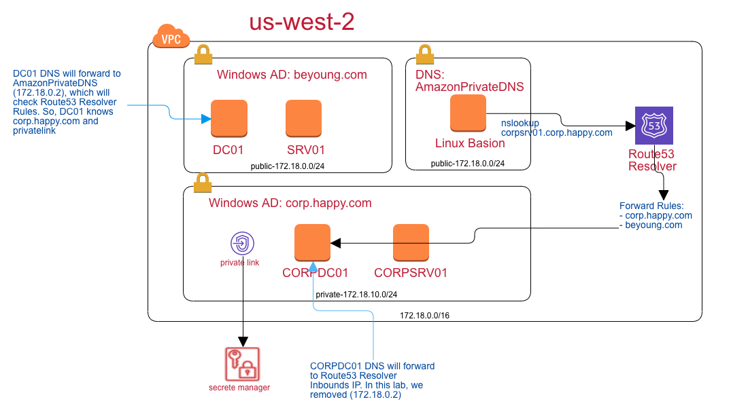
Implement the following architecture diagram

Slide 3
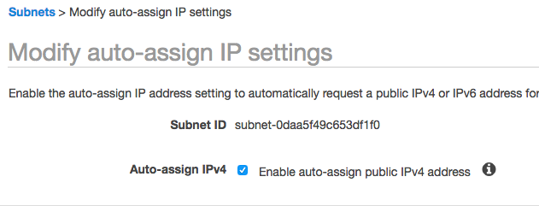
VPC Setup
Region: us-west-2
IP: 172.18.0.0/16
public sub: 172.18.0.0/24 and turn on the auto-assign public ip

Slide 4
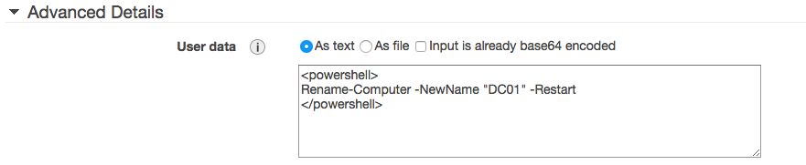
Build your active directory in AWS EC2
Images: Microsoft Windows Server 2016 Base
t2.2xlarge
Add customize scripts

Slide 5
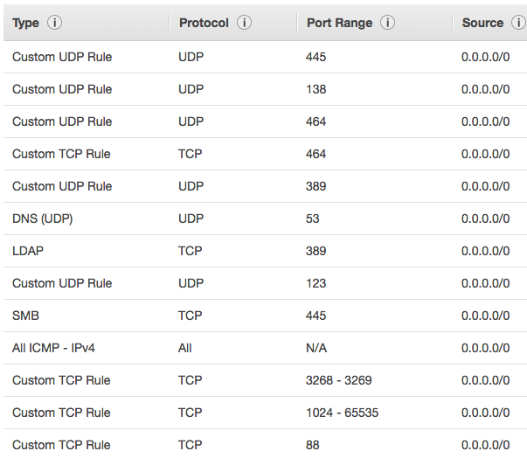
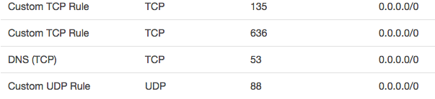
Winodws AD Secruity Group

Slide 6
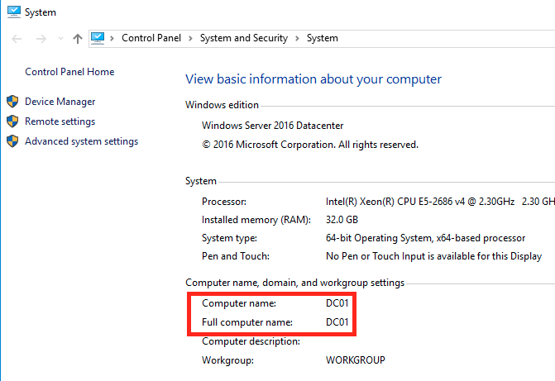
Config the AD

Slide 7
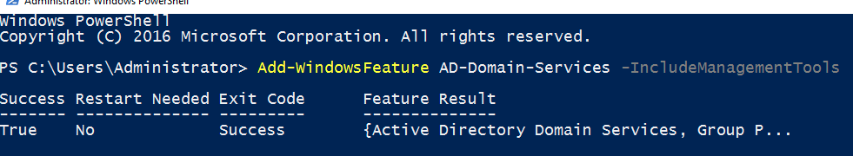
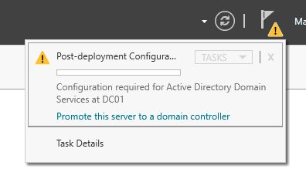
PowerShell
Add-WindowsFeature AD-Domain-Services –IncludeManagementTools
Command line to open Server Manager. In the right up corner. Promote this server as domain controller.

Slide 8
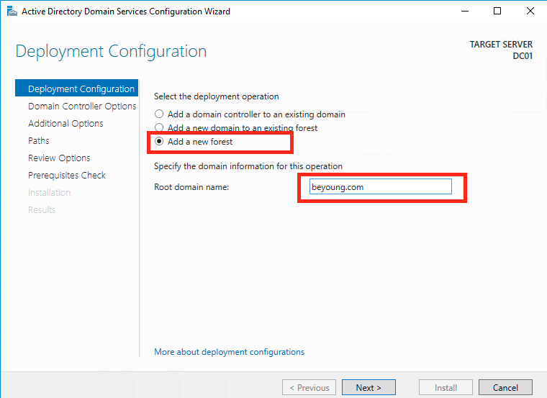
.
.

Slide 9
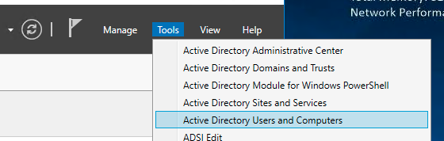
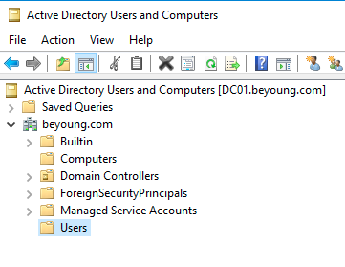
.
NetBIOS name: BEYOUNG After completing the wizard, the server will be restarted and the server will be ready to be used.

Slide 10
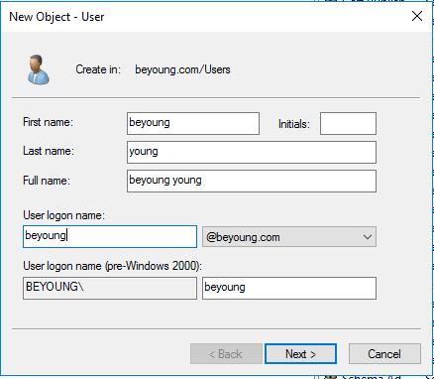
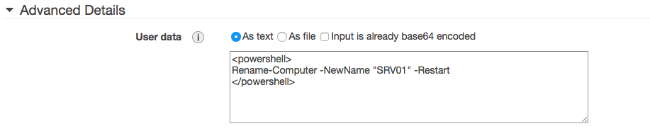
Add a domain user

Slide 11
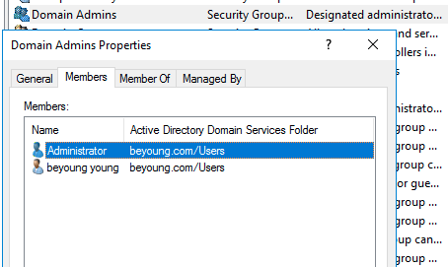
Add DC user to the Domain Admins Group
Notes: You must create a new user here. Later on, you can't use local administrator to login your EC2.

Slide 12
Add a server into the DC
<powershell> Rename-Computer -NewName "SRV01" -Restart </powershell>

Slide 13
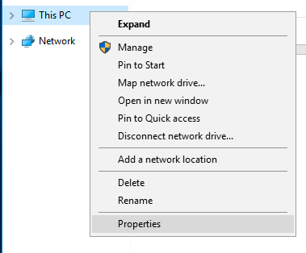
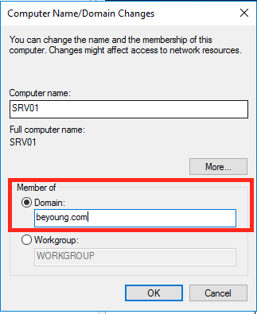
Add to domain
Control Panel > System and Security > System

Slide 14
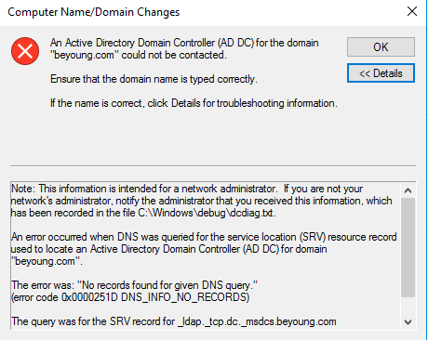

Slide 15
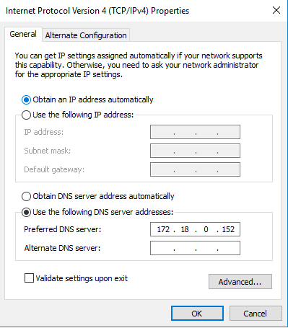
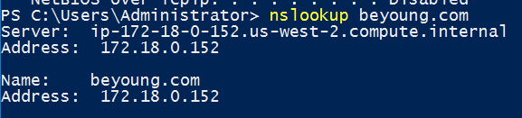
Change the network DNS record to the DC01 private ip.

Slide 16
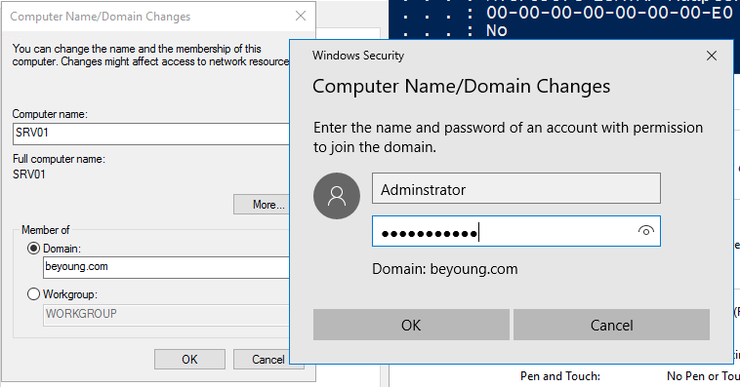
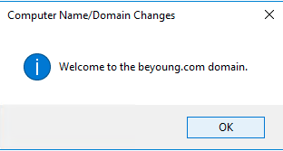
Join the domain again.

Slide 17
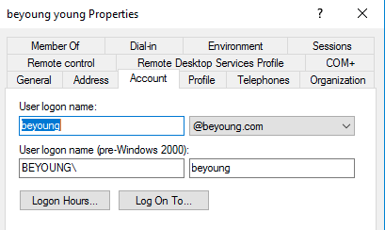
.
Restart your computer
Use the domain name to login
In the DC, make sure the login format of the domain user.

Slide 18
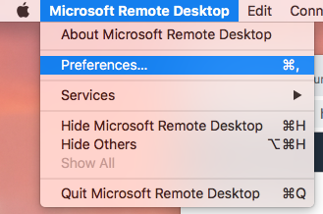
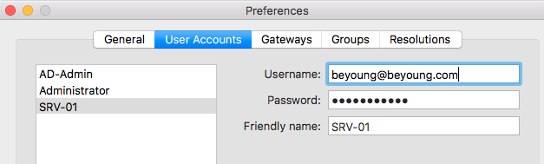
In the remote desktop configuration, change to the domain user login:

Slide 19
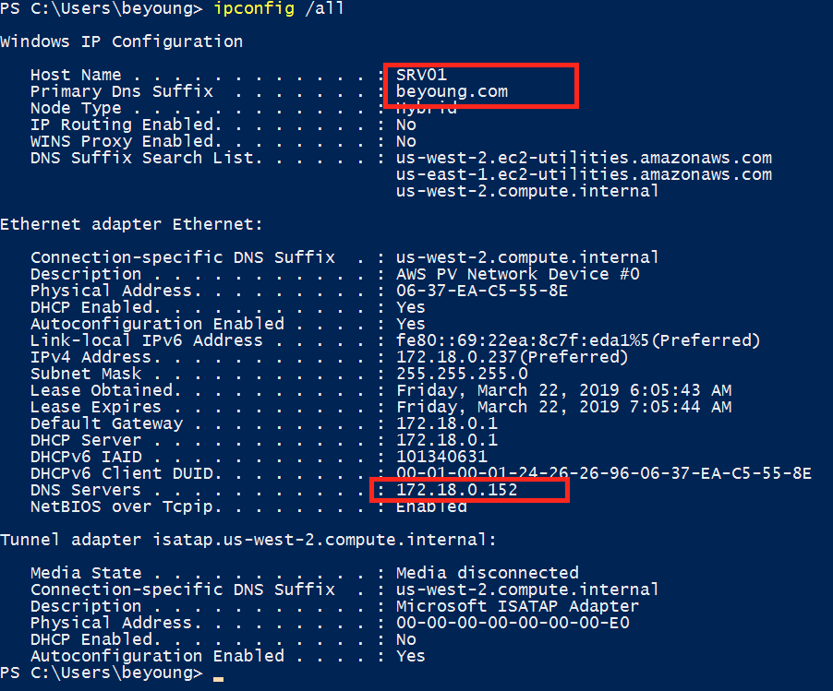
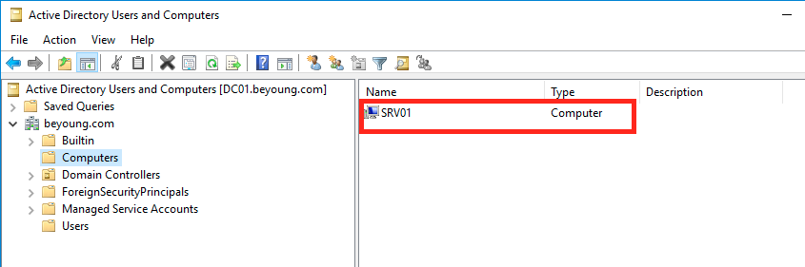
login to SRV01 using the DC users.

Slide 20
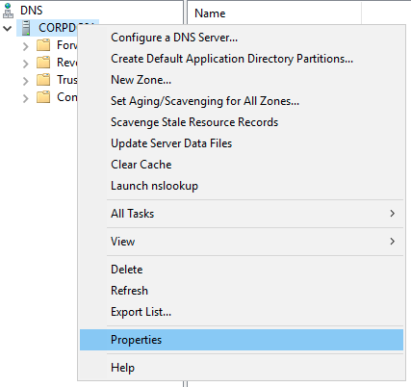
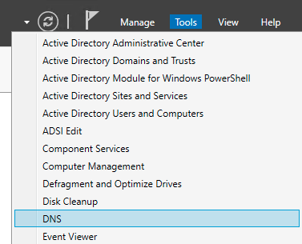
Deep Dive on the DNS setting
You will found that Windows AD can resolve the private link. The major reason is at the DNS Forwarder.

Slide 21
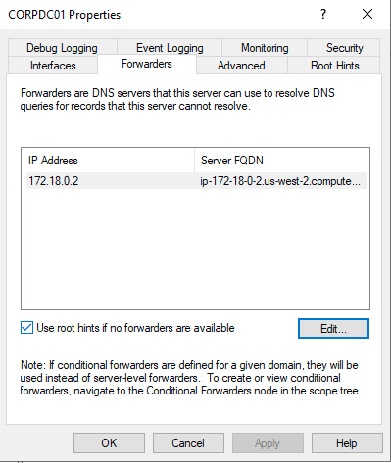
If you remove the forwarder .2 server, you found that you can not get the private link information:

Slide 22
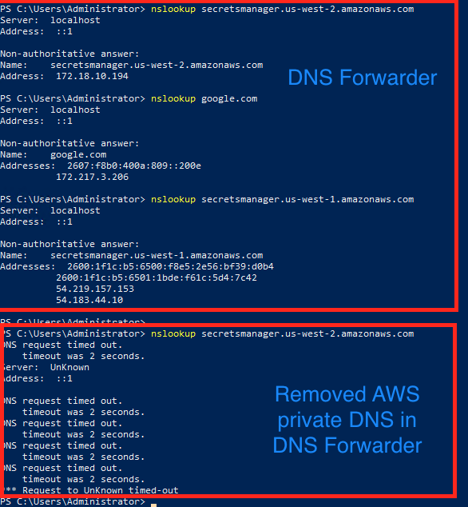

Slide 23
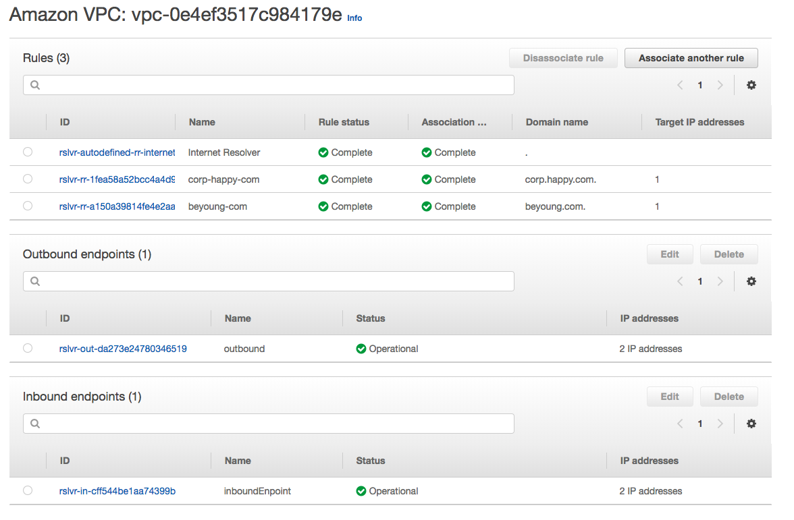
Route 53 resolver
Setup Rout53 Resolver

Slide 24
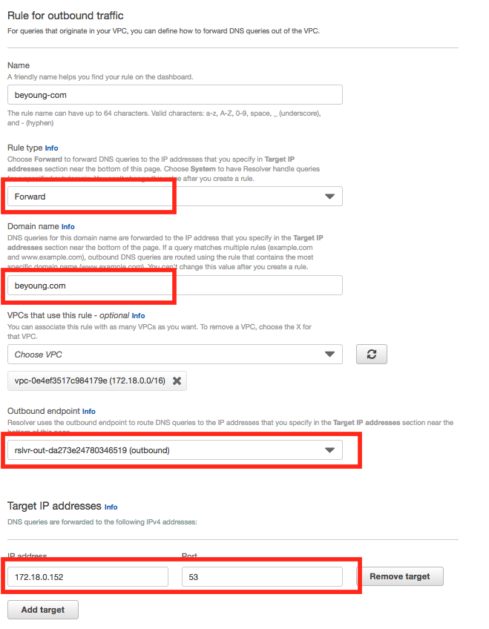
create the outbounds roles

Slide 25
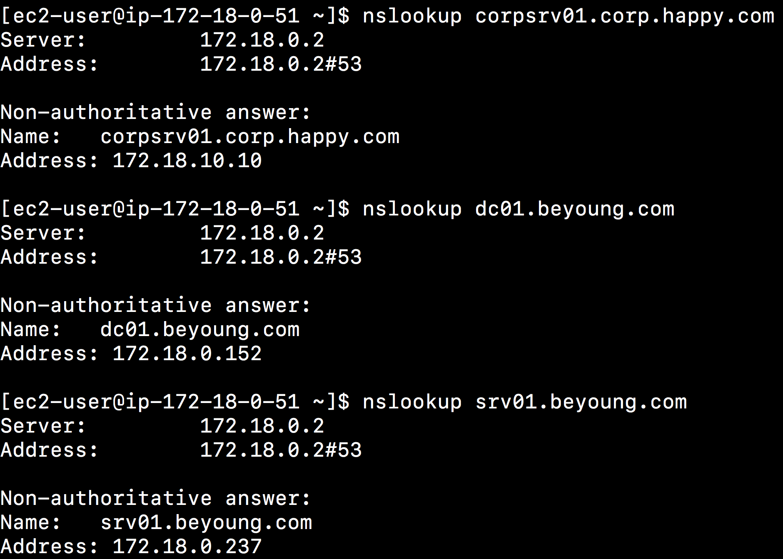
Now, you can get information for private AD information

Slide 26
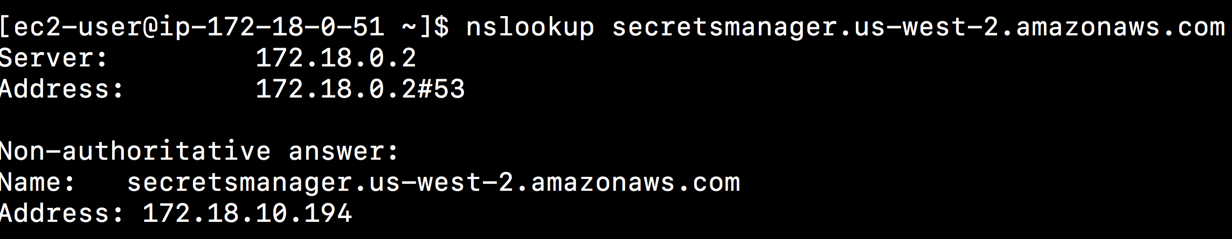
Also, when you query about the private links, you can get the correct results

Slide 27
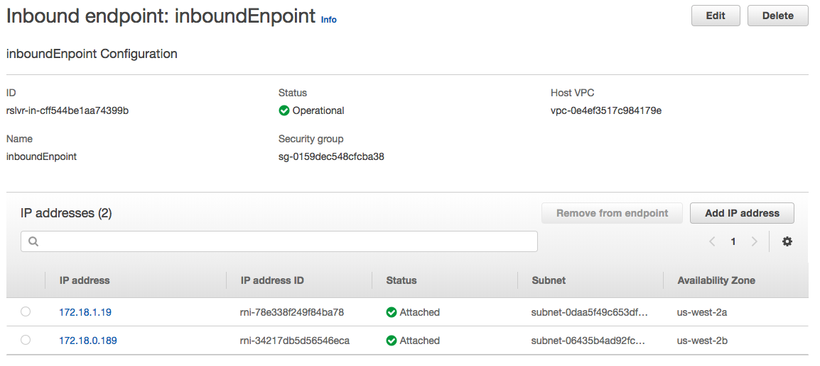
Change CORP DNS forwarder to Route53 resolver inbound

Slide 28
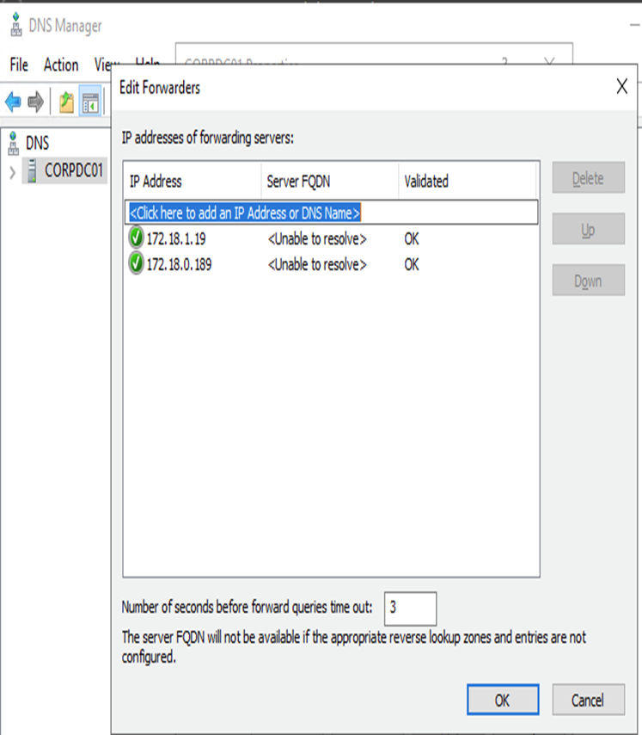

Slide 29
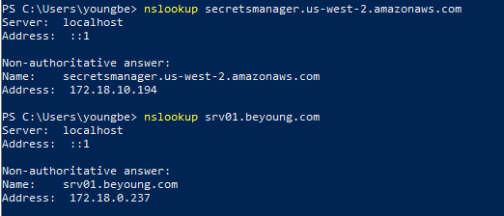
Now, the corp machine can query AWS private links and private domain of AD such as beyoung.com
.

Slide 30
.
Thank you

